Slide 1
COMP 51 Week Nine
File I/O

Slide 2
Learning Objectives
I/O Streams
File I/O
Character I/O
Stream Hierarchies
Preview of inheritance

Slide 3
Why Do We Care
Back to I-P-O
Need to get data in and out of our programs
Persistent Storage
Automation
String Program Execution Together
Hand off of data
Don’t want to hand enter data all the time
Notes:
use cases – FB, Twitter, email, using files/DBs

Slide 4



Streams of Data
Input Stream
Flow into program from File, DB or Keyboard
Output Stream
Flow out of program into file, screen , or DB
Notes:
Streams
Special objects
Deliver program input and output

Slide 5
Streams Usage Like cin, cout
Given program defines stream inStream that comes from some file: int theNumber; inStream >> theNumber;
Program defines stream outStream that goes to some file outStream << "theNumber is " << theNumber;
Notes:
We’ve used streams already
cin
Input stream object connected to keyboard
cout
Output stream object connected to screen
Can define other streams
To or from files
Used similarly as cin, cout

Slide 6
Declaring Streams
Stream must be declared like any other variable: ifstream inStream; ofstream outStream;
Must then "connect" to file: inStream.open("infile.txt");
Called "opening the file"
“Dot” notation → Uses member function open
Can specify complete pathname

Slide 7
Opening a Text File
Add at the top
#include <fstream> using namespace std;
You can then declare an input stream just as you would declare any other variable.
ifstream inputStream;
Next you must connect the inputStream variable to a text file on the disk.
inputStream.open("filename.txt");
The “filename.txt” is the pathname to a text file or a file in the current directory
Output File → ofstream object

Slide 8
Reading from a Text File
Use
inputStream >> var;
The result is the same as using cin >> var except the input is coming from the text file and not the keyboard
When done with the file close it with
inputStream.close();

Slide 9
File I/O Libraries
To allow both file input and output in your program: #include <fstream> using namespace std; OR #include <fstream> using std::ifstream; using std::ofstream;

Slide 10
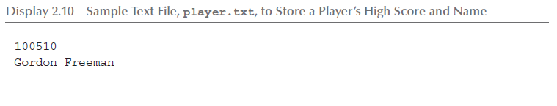
File Input Example (1 of 2)
Consider a text file named player.txt with the following text

Slide 11
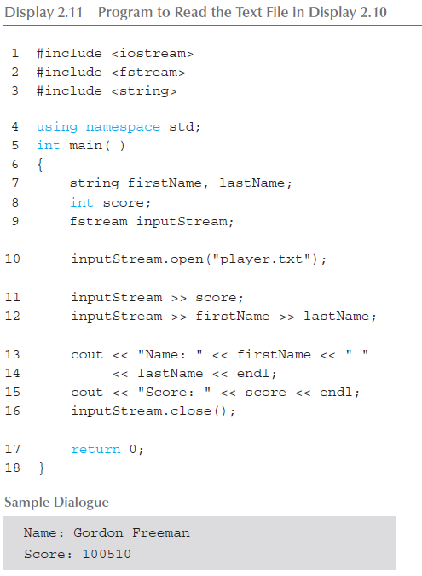
File Input Example (2 of 2)

Slide 12
Streams Usage
Use same syntax as cin, cout int oneNumber, anotherNumber; inStream >> oneNumber >> anotherNumber;
Output stream similar: ofstream outStream; outStream.open("outfile.txt"); outStream << "oneNumber = " << oneNumber << " anotherNumber = " << anotherNumber;
Sends items to output file

Slide 13
File Names vs Stream Names
External file name
Also called "physical file name"
Like "infile.txt"
Sometimes considered "real file name"
Used only once in program (to open)
Stream name
Also called "logical file name"
Program uses this name for all file activity

Slide 14
Closing Files
Files should be closed
When program completed getting input or sending output
Disconnects stream from file
Syntax: inStream.close(); outStream.close();
Note no arguments
Open files suck resources
Files automatically close when program ends

Slide 15
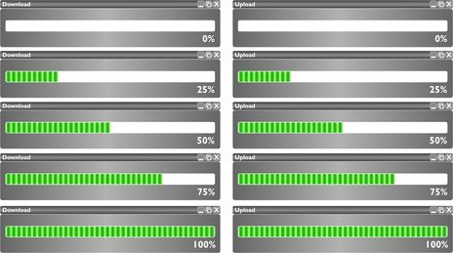
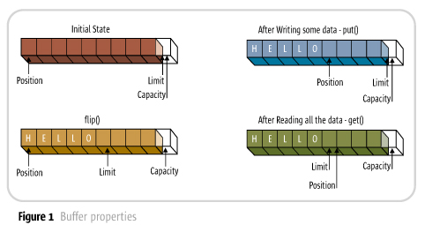
File Flush
Output often "buffered"
Temporarily stored before written to file
Written in "groups"
Occasionally might need to force writing: outStream.flush();
Member function flush, for all output streams
All buffered output is physically written
Good for log or debug files
Closing file automatically calls flush()

Slide 16
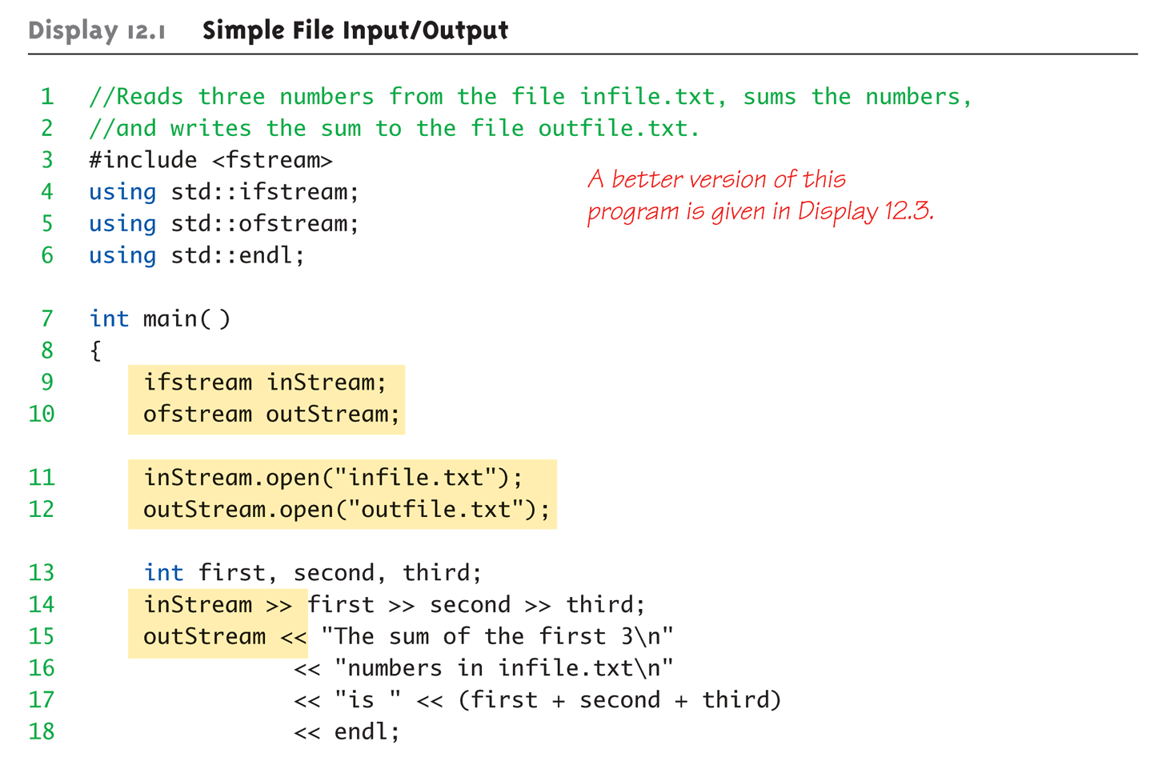
Simple File Input/Output (1 of 2)

Slide 17
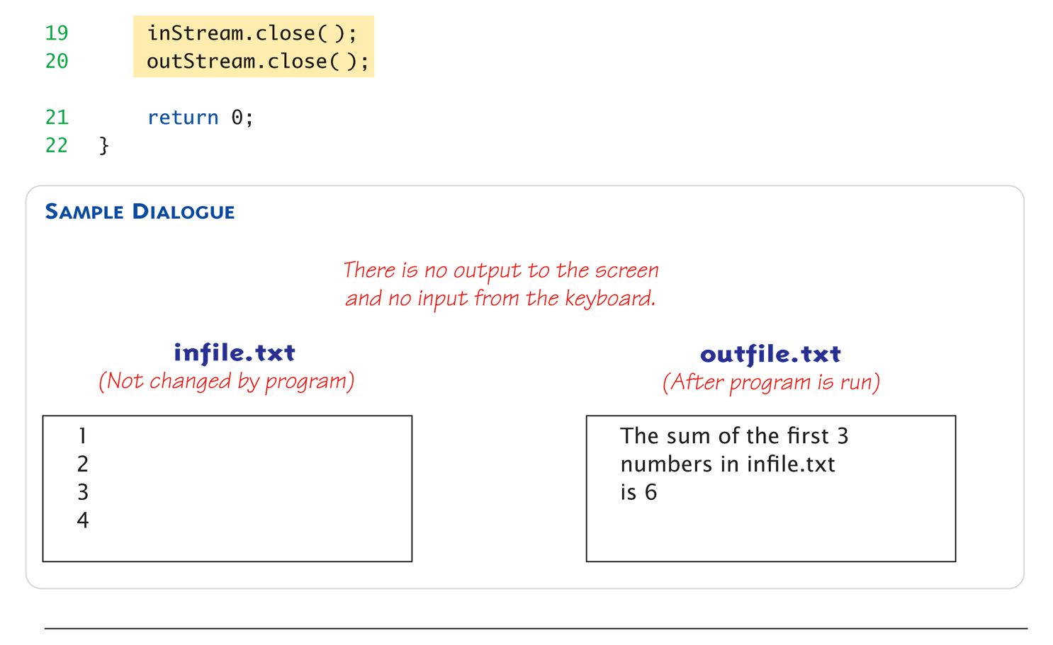
Simple File Input/Output (2 of 2)

Slide 18
File Practice Inventory Counts
Create a new project – fileiopractice
#include <fstream>
#include <string>
using namespace std;
Download sample file from Sakai – Lab Solutions → inventorycount.txt
Save it to C:\Users\yourname\Documents\Visual Studio 2010\Projects\fileiopractice\fileiopractice
Xcode Users – see notes on slide
Declare the following variables
ifstream inStream;
ofstream outStream;
double cost, value;
int qty;
string prodId, prodDescr;
Write the following statements
Input command to read the file (use one cin statement to get all fields)
Calculate the value of inventory = cost * qty
Output command to write prodId and value (remember to include spaces between values)
Notes:
Option One:
Put your .txt files in the same directory where your main.cpp file is (or anywhere you like).
In Xcode go to Product > Scheme > Edit Scheme > Run test (on the right) > Options (middle top)
Down under Options check “Use custom working directory” and set it to the directory where you .txt files are located.
Option Two:
To change the working directory when you're running from inside XCode: select "Edit Active Executable" in your "Project" menu.
You can adjust your working directory settings at the bottom of the "General" section.

Slide 19
Appending to a File
Standard open operation begins with empty file
Even if file exists → contents lost
Open for append: ofstream outStream; outStream.open("important.txt", ios::app);
If file doesn’t exist → creates it
If file exists → appends to end
2nd argument is class ios defined constant
In <iostream> library, std namespace

Slide 20
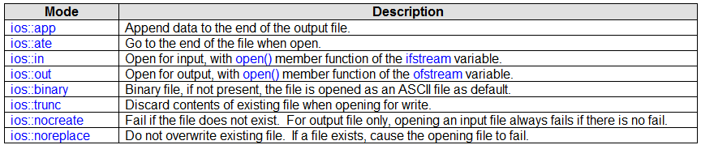
Other File Options

Slide 21
Alternative Syntax for File Opens
Can specify filename at declaration
Passed as argument to constructor
ifstream inStream; inStream.open("infile.txt"); EQUIVALENT TO: ifstream inStream("infile.txt");

Slide 22
File Failure is Always an Option
File opens could fail
If input file doesn’t exist
No write permissions to output file
Unexpected results
Member function fail()
Place call to fail() to check stream operation success inStream.open("stuff.txt"); if (inStream.fail()) { cout << "File open failed.\n"; exit(1); }

Slide 23
Character I/O with Files
Remember how cin/cout works!
Member functions work same:
get, getline
put, putback,
peek, ignore

Slide 24
Checking End of File Option One
Loop to process file until end
Member function eof() inStream.get(next); while (!inStream.eof()) { cout << next; inStream.get(next); }
Reads each character until file ends
eof() member function returns bool

Slide 25
End of File Check with Read Option Two
read operation returns bool value! (inStream >> next)
Expression returns true if read successful
Returns false if attempt to read beyond end of file
Example: double next, sum = 0; while (inStream >> next) sum = sum + next; cout << "the sum is " << sum << endl;

Slide 26
Processing Multiple Records Practice
Modify the inventory code to loop through the input file one line at a time.
Use Option Two to check for end of file
Re-use the cin statement from the original code. Wrap this in a while statement

Slide 27
Prompt File Names as Input
Stream open operation
Argument to open() is string type
Can be literal (used so far) or variable char fileName[16]; ifstream inStream; cout << "Enter file name: "; cin >> fileName; inStream.open(fileName);
Provides more flexibility

Slide 28
Output Stream Formatting
Review "magic formula": cout.setf(ios::fixed); cout.setf(ios::showpoint); cout.precision(2);
Outputs numbers in "money" form (12.52)
Can use on any output stream
File streams have same member functions as cout object
outStream.setf(ios::fixed); outStream.setf(ios::showpoint); outStream.precision(2);
Notes:
Consider: Member function precision(x)
Decimals written with "x" digits after decimal
Member function setf()
Allows multitude of output flags to be set

Slide 29
Output Flags setf() Examples
Common flag constants:
outStream.setf(ios::fixed);
Sets fixed-point notation (decimal)
outStream.setf(ios::showPoint)
Always include decimal point
outStream.setf(ios::right);
Sets right-justification
Flags are constants in class ios
In library <iostream>, std namespace
Set multiple flags with one call: outStream.setf(ios::fixed | ios::showpoint | ios::right);

Slide 30
More Output Member Functions
Consider: outStream.width(5);
Member function width(x)
Goal to create columns in the output file
Sets width to "x" for outputted value
Only affects "next" value outputted
Must set width before each value in order to affect all

Slide 31
Saving Flag Settings Example
void outputStuff(ofstream& outStream) { int precisionSetting = outStream.precision(); // save old values long flagSettings = outStream.flags(); outStream.setf(ios::fixed | ios::showpoint); outStream.precision(2);
// output some data outStream.precision(precisionSetting); // restore old values outStream.flags(flagSettings); }
Function to save & restore "typical" settings
Call: outputStuff(myStream);
Notes:
Flag settings "stay" until changed
Precision and setf flags can be saved and restored
Function precision() returns current setting if called with no arguments
Member function flags() provides similar capability

Slide 32
Restoring Default setf Settings
Can also restore default settings: cout.setf(0, ios::floatfield);
Not necessarily the "last" setting!
Default values are implementation- dependent
Does not reset precision settings
Only setf settings

Slide 33
Manipulators
Manipulator defined: "A function called in nontraditional way"
Can have arguments
Placed after insertion operator
Do same things as member functions!
In different way
Common to use both "together"
setw() and setprecision() are in library <iomanip>, std namespace

Slide 34
Manipulator Example: setw()
setw() manipulator: cout << "Start" << setw(4) << 10 << setw(4) << 20 << setw(6) << 30;
Results in: Start 10 20 30
Note: setw() affects only NEXT outputted value
Must include setw() manipulator before each outputted item to affect all

Slide 35
Manipulator setprecision()
setprecision() manipulator: cout.setf(ios::fixed | ios::showpoint); cout << "$" << setprecision(2) << 10.3 << " " << "$" << 20.5 << endl;
Results in: $10.30 $20.50

Slide 36
Learning Objectives
I/O Streams
File I/O
Character I/O
Stream Hierarchies
Preview of inheritance

Slide 37
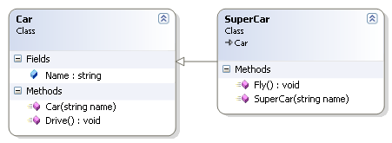
Class Inheritance "Real" Example
Class of all convertibles is derived from class of all automobiles
Every convertible is an automobile
Convertible "adds features" to automobile
A SuperCar can still drive and have a name

Slide 38
Stream Hierarchy
istream
Keyboard
cin
File Stream
.open
.close
Notes:
Class Relationships
"Derived from"
One class obtained from another class
Then features are "added"
Example:
Input file streams class is derived from class of all input streams
It then adds open and close member functions
i.e.: ifstream is derived from istream

Slide 39
Stream Class Inheritance
Consider:
If D is derived class of class B →
All objects of type D are also of type B
e.g., A convertible is also an automobile
Regarding streams:
An ifstream object is also an istream object
Should use istream objects for parameters
More objects can be plugged in!

Slide 40
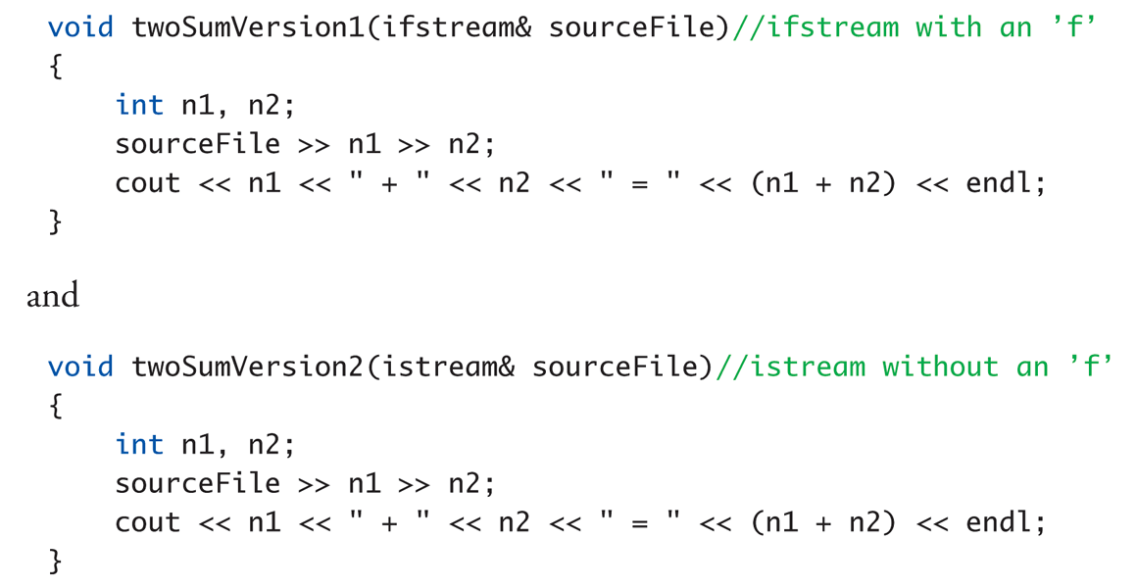
Stream Class Inheritance Example
twoSumVersion1(fileIn); // Legal!
twoSumVersion1(cin); // ILLEGAL!
Because cin is not of type ifstream!
twoSumVersion2(fileIn); // Legal!
twoSumVersion2(cin); // Legal!
istream parameter accepts both objects

Slide 41
The Stringstream Class
The stringstream class is another example of inheritance
Derived from the iostream class
Allows you to perform stream operations to or from a string, similar to how you perform stream operations from cin or from a file
Shares or inherits the same methods
Useful for converting strings to other data types and vice versa

Slide 42
Using stringstream
Required to use
#include <sstream>
using std::stringstream;
Create an object of type stringstream
stringstream ss;
ss.clear( ); // reset contents to empty string
ss.str(""); // initialize to blank
To create a string from other variables
ss << c << " " << num; // create a string : c is a char, num is an int
ss << "x 10";
ss >> c >> num; // parse a string : c is set to 'x' and num is set to 10
Notes:
This class is sometimes useful when reading a string from some source and extracting fields from the string

Slide 43
stringstream Example (1 of 3)
//Demonstration of the stringstream class. This program takes
//a string with a name followed by scores. It uses a
//stringstream to extract the name as a string, the scores
//as integers, then calculates the average score. The name
//and average are placed into a new string.
#include <iostream>
#include <string>
#include <sstream>
using namespace std;
int main( )
{
stringstream ss;
string scores = "Luigi 70 100 90";
What if we wanted to define an array of scores?

Slide 44
stringstream Example (2 of 3)
// Clear the stringstream
ss.str("");
ss.clear();
// Put the scores into the stringstream
ss << scores;
// Extract the name and average the scores
string name = "";
int total = 0, count = 0, average = 0;
int score;
ss >> name; // Read the name
while (ss >> score) // Read until the end of the string
{
count++;
total += score;
}

Slide 45
stringstream Example (3 of 3)
if (count > 0)
{
average = total / count;
}
// Clear the stringstream
ss.clear();
ss.str("");
// Put in the name and average
ss << "Name: " << name << " Average: " << average;
// Output as a string
cout << ss.str() << endl;
return 0;
}

Slide 46
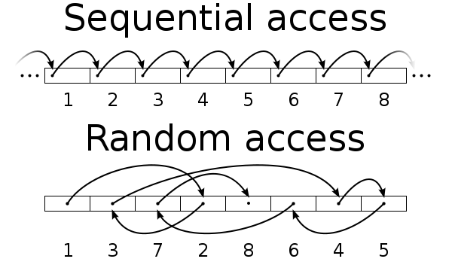
Random Access to Files
Use fstream objects to access any part of file
Notes:
Sequential Access
Most commonly used
Random Access
Rapid access to records
Perhaps very large database
Access "randomly" to any part of file
Use fstream objects
input and output

Slide 47
Random Access Tools
Declaration
fstream rwStream;
Opens same as istream or ostream
rwStream.open("stuff", ios::in | ios:: out);
Move about in file
rwStream.seekp(1000);
Positions put-pointer at 1000th byte for writing
rwStream.seekg(100);
Positions get-pointer at 100th byte for reading
Required second argument.
Ex – opens both read and write

Slide 48
Random Access Sizes
To move about → must know sizes
sizeof() operator determines number of bytes required for an object: sizeof(s) //Where s is string s = "Hello" sizeof(10) sizeof(double) sizeof(myObject)
Position put-pointer at 100th record of objects: rwStream.seekp(100*sizeof(myObject) – 1);

Slide 49


Other File Types You Will Encounter
XML Data Sets
Tagged language like HTML
CSV or Excel Data Files
Ex. "Mike", "Canniff ","988111222 ","Weber 204“
Databases
Complex rows, columns, and tables

Slide 50
Key Takeaways
Streams used to connect to files
__________ opens a file
.close() closes a file
_________ checks for failure when accessing file
Streams use inheritance to share common methods and variables in an “is-a” relationship between classes
Fstream is-a istream

